Slide 1
Notes:
You will need: Rucksack, bread, bottle of clear and dirty water, sleeping bag or tarpaulin, First Aid or plasters, a book, a cut out paper heart.
A volunteer who can emerge from the back of the room with a big bag after Slide 3.
Introduce yourself.
Some of the things I’m going to talk to you about today might be a little worrying or concerning. If at any point you would like to step outside, please feel free to do so. We can talk to you separately afterwards, or you can speak to a teacher or pastoral support person on site

Slide 2
You will need for this assembly:
Timings: Ideal for a 15 minutes to 30 minute assembly with primary school children of all ages.
You will need:
- Rucksack or container for your items, bread, bottle of clear and dirty water, sleeping bag or tarpaulin, First Aid or plasters, a book, a cut out paper heart. You may also want to add additional items that relate to children’s rights here.
- A video projector and audio to show the video (however you can still do the assembly cutting out this section if you don’t have these in your school).
- A volunteer who can emerge from the back of the room with a big bag after Slide 3.
Structure: (more detailed speaker notes are in the notes under each slide)
Introduce yourself and Save the Children.
Explain to the children that in your mystery box there are clues to some of the things that all children need to live happy and healthy lives – and what Save the Children does
Unpack the rucksack item by item – the order doesn’t matter, but leave the heart until last. You can also ask volunteers from the audience to help you. As you hold up each item ask the children what it is a clue for – you will usually get the “correct” answer eventually! (Food water, shelter, health, education, protection + love)
Talk about how Save the Children fulfils each right – for example by providing shelter to children whose homes were destroyed by a Cyclone.
Show the video case study of a child refugee and ask children how they feel seeing the video, the things Saja doesn't have and what Save the Children is providing, putting into practice what they have learned about children’s rights from the rucksack activity.
Introduce children to the question what we can do to help children like Saja. Talk about fundraising to meet immediate needs and campaigning to use our voices together to create longer term change – and how they can get involved.
If time, ask pupils to feed back on what they learned and enjoyed, and what they want to change in the world.
Finish your presentation with the idea that Save the Children believe that children everywhere have a right to all these things, so that they have happy, healthy and secure childhoods.
Notes:
You will need: Rucksack, bread, bottle of clear and dirty water, sleeping bag or tarpaulin, First Aid or plasters, a book, a cut out paper heart.
A volunteer who can emerge from the back of the room with a big bag after Slide 3.
Introduce yourself.
Some of the things I’m going to talk to you about today might be a little worrying or concerning. If at any point you would like to step outside, please feel free to do so. We can talk to you separately afterwards, or you can speak to a teacher or pastoral support person on site

Slide 3
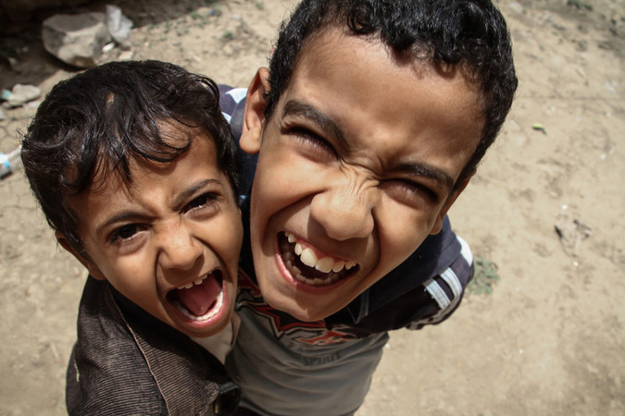
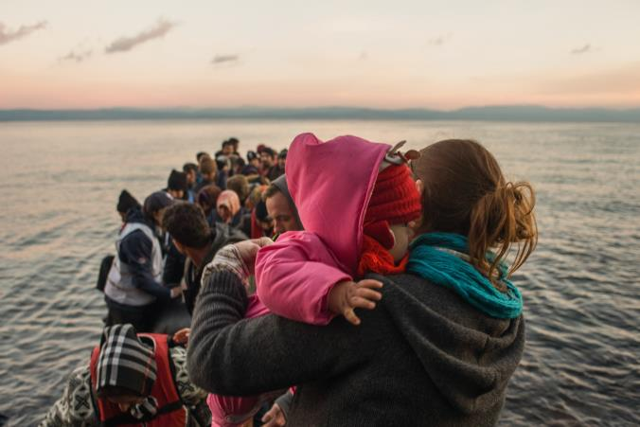
What is a charity?
What is Save the Children?
Notes:
1. Ask Children:
Does anyone know what a charity is?
“an organisation that provides help for those in need.”
Charities can do all sorts of different things (maybe ask children if they can think of any other charities) e.g. look after older people or protect the environment
Today we’re going to talk to you about the charity we work for, called Save the Children? Does anyone know what Save the Children does?
At Save the Children we save children’s lives and help them to develop and thrive. We work in more than 120 countries around the world (!) including the UK to make sure that children are happy, healthy and safe.
We’re just talked about helping people IN NEED. We’re going to think about what that means; what are some of the things that we NEED and the things that we just WANT?
Photo 1:Hazim*, 10 years old, and his brother Fuad, 5 years old. We are helping children like them who have been affected by the war in Yemen.
Photo 2: This photo shows refugees arriving in Lesvos, Greece. They have had to leave their homes because of war or poverty and have travelled a very long way in search of safety.

Slide 4
Needs
or
Wants?
Notes:
We’ve just talked about helping people IN NEED. We’re going to think about what that means; what are some of the things that we NEED and the things that we just WANT?
We’re going to give you a few examples. Raise your hand if they think it’s a need or a want.
Needs and wants activity. 2 or 3 things – teacher to build on if they like.
Going to school – important to help you grow, develop, and give you opportunities when you grow up so you can do whatever you want to do
Getting Fifa 2018 – important that every child is able to play, and free to play, but specifically Fifa is not something that every child needs to survive and be health, safe and healthy.
Going to the hospital if I’m sick – so important. How would you feel if you couldn’t do that?
((Wifi)) – links to other rights, education
Every child around the world should have these really important NEEDS met, no matter of their gender, their religion, their race or where they live.
However, unfortunately there are some children around the world who can’t go to hospital when they are sick, because they live in places where there are no doctors and hospitals. If they get sick their parents might not have the money to buy medicine and have to travel a very long way to get help.
This might be because they are living in a place where there is a war, or there has been a flood or an earthquake, or simply that they live in very poor places very far away from hospitals.
Save the Children is changing this, by helping to provide healthcare to children who don’t have it.
We’re now going to use our understanding of NEEDS and WANTS to think a little but more about what Save the Children does to help children in NEED around the world.

Slide 5
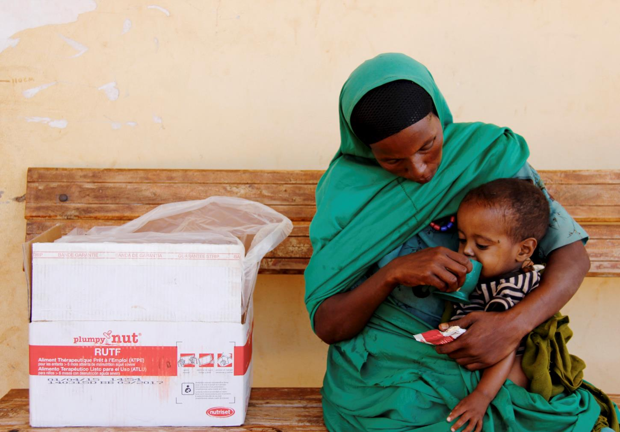
FOOD
Notes:
We’re going to use our understanding of NEEDS to think about what Save the Children do.
We’re going to get my colleague Alicia in to show us a bit more about what Save the Children do…. Alicia enters. Alicia’s bag is full of clues as to some of the things STC does to help children in need around the world.
It’s important to remember that although we will have access to lots of these clues / needs, lots of children around the world do not….
Through this game we are going to use these clues to think about the really important things that we all not to survive and be healthy and happy – and what Save the Children as a charity helps to provide children with.
Can I have 2/3 volunteers to help me unpack Alicia’s bag.?
With every item you pick out of the bag, I’d like you to think what the object is and why it might be important in helping children in need?
FOOD – hold up loaf of bread / plumpy nut
What is this?
Why do you think it’s important in helping children?
Why might some children not have those things?
(Did we have something like this in our own bags this morning? Why is it important that every child has this?)
Key message: There is enough food for everyone in the world but some children don’t have any. This might be because food is too expensive for some people to pay for it or because it’s hard to get where they live.
Save the Children helps by bringing food to people who need it. We also help people to grow their own food, by providing them with seeds and teaching them new farming techniques, so they will have enough for the future.
This photo is two-year-old Seid from Ethiopia with his mum Yesriba. Seid got sick because he didn’t have enough food to eat. Save the Children gave his mum some Plumpy Nut paste to feed him. Three sachets a day includes all of the nutrients he needs to get better and be healthy again.
(If possible can show PlumpyNut sachet or a MUAC band)

Slide 6
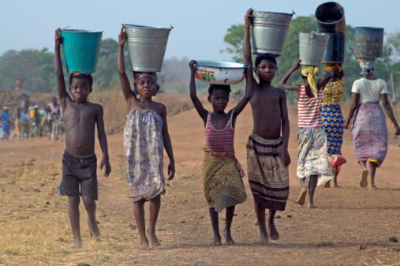
WATER
Notes:
WATER – hold up dirty and clean bottle of water
What is this?
Which of these would you like to drink? Some children don’t have a choice, and have to walk for hours to get clean drinking water.
Why do you think it’s important in helping children?
Why might some children not have those things?
(Did we have something like this in our own bags this morning? Why is it important that every child has this?)
Key message: Save the Children work to ensure people have access to clean water – building wells, chlorine tablets, fixing existing systems.
Fatuma*, Adnan*, Amina* and Madelo* live a village in Sitti Zone, Somali Region of Ethiopia. They are brothers and sisters.
There is a drought there currently, and the children have to walk for 2 hours every day to get clean drinking water from a well in the nearest village – and then 2 hours back. They try to do it early in the morning, but sometimes they don’t get back in time for school, and miss their classes as a result. They are worried that they will fall behind with their education.
Save the Children is already on the ground in Ethiopia, helping victims of the drought.
We are working in over 70% of the worst-affected woredas districts in Ethiopia providing food water medicine and crucial support to families who have lost their incomes. We are providing nutrition support to children and families facing shortages and intervening to save livestock and crops where possible.

Slide 7
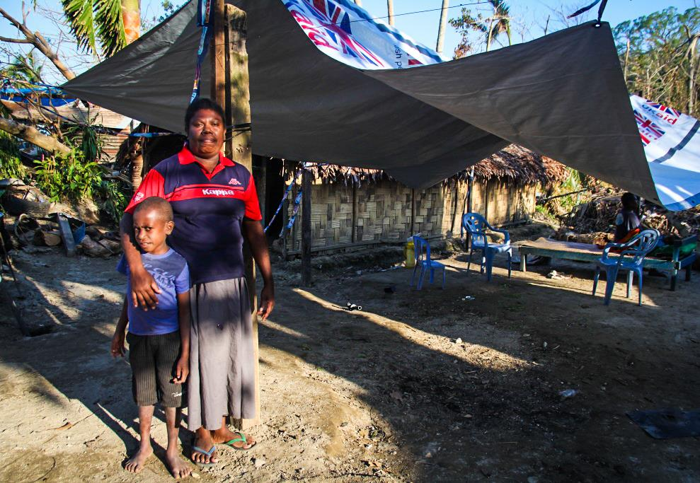
SHELTER
Notes:
SHELTER – Hold up a sleeping bag / tarpaulim
What is this?
Why do you think it’s important in helping children?
Why might some children not have those things?
(Did we have something like this in our own bags this morning? Why is it important that every child has this?)
Key message: Save the Children provide vital shelter to families in emergency situations and work with them long-term to help them rebuild their homes and livelihoods. We also work with children who live on the streets helping to find them a safe home.
Pictured is Mary with her 8 year old son Samuel. Mary’s home in Vanuatu, an an island in the Pacific Ocean is right by the water, and during Cyclone Pam the water flooded her home above head height. She only learned about the cyclone a few hours before it struck and she was among the last to leave her community.
When she and her husband returned the next day they found one of their trucks lying upside down in the river by their house.
Mary and her family benefited from Save the Children’s daily food distribution immediately after the cyclone and also received two tarps and two ropes to temporarily repair their damaged home, so they could be protected from the wind and rain.
Mary’s story
“We only heard about the cyclone at about 2pm the day it hit, and we were told it would hit at 6pm. We moved out of this area where we live. I was one of the last people to get out. People were panicked, and fled without their belongings. When I left at 6pm my husband was still here.
“I went to my brothers place nearby with our two children. He has a concrete house, it’s very strong. Then suddenly we heard the ceiling and roof rumble.
“The next morning my husband went to see the house and he told us we had lost everything. When we came home we saw people swimming around because the water was so high. Everything was damaged.
“It was really hard to come back because everything was gone. A week on now, we are facing the reality that we need to clean our house up, to mop the floors and rebuild our lives. In the first days Save the Children came and gave us rice and food, then they came back with toothpaste and soap, then yesterday tarpaulins.
“The tarp was given to cover the roof up. This should help us for some time so we can find the money to rebuild. This is temporary to cover up the roof.”

Slide 8
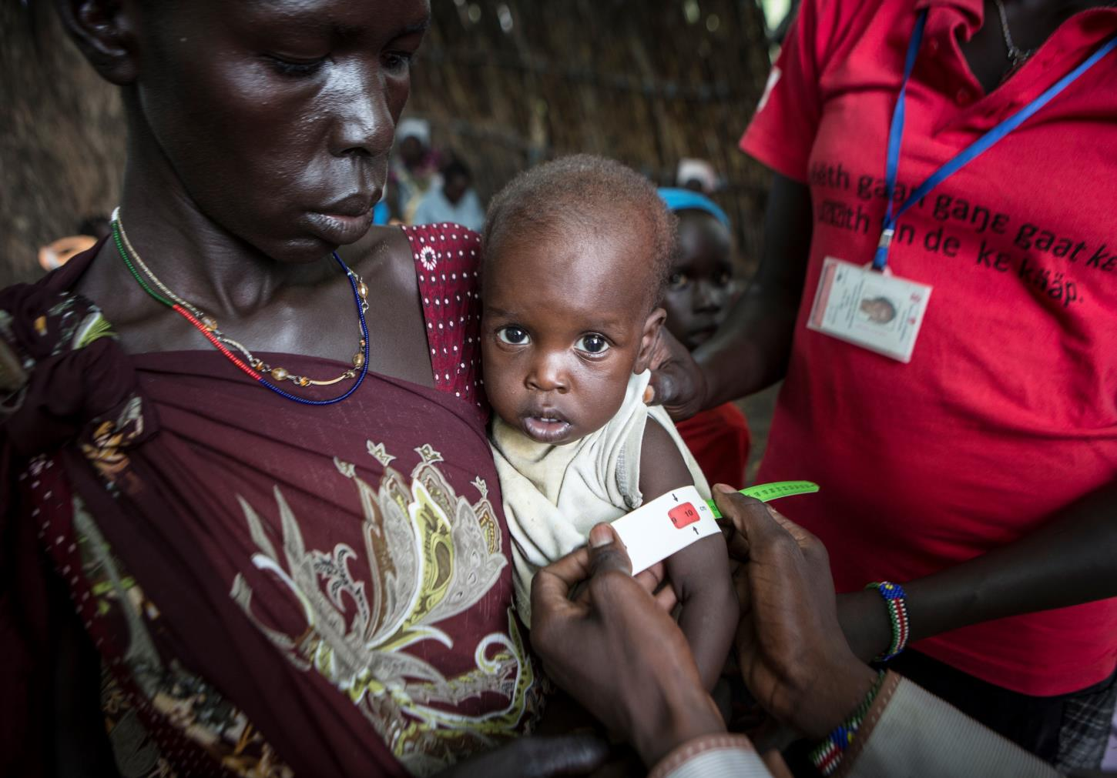
HEALTH
December 2017
Notes:
HEALTH – Hold up First Aid kit.
What is this? // Could ask "who has ever been to the doctor before?" or "who has ever been given an injection or medicine when they have felt poorly?"
Why do you think it’s important in helping children?
Why might some children not have those things?
(Did we have something like this in our own bags this morning? Why is it important that every child has this?)
Key message: Save the Children exists to save children’s lives. Some children live in places where there are no doctors and hospitals. They do not have easy access to immunisations which keep them safe from diseases. If they get sick their parents might not have the money to buy medicine and have to travel a very long way to get help.
Save the children is changing this. We are training more doctors and nurses to look after people and giving medicine to children who need it.
Photo: This photo shows baby Nyadbeg*, 10 months is receiving treatment at a Save the Children clinic in Akobo, South Sudan.

Slide 9
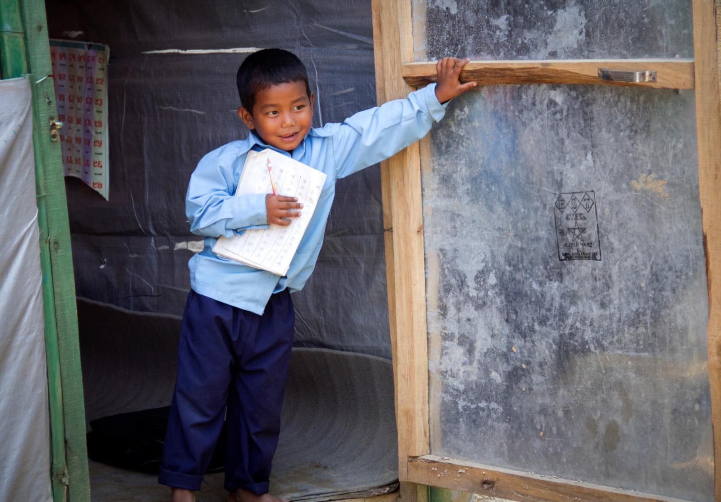
EDUCATION
Notes:
EDUCATION – Hold up Exercise book and pencil
What is this?
Why do you think it’s important in helping children? Why do your parents send you to school?
Why might some children not have those things?
(Did we have something like this in our own bags this morning? Why is it important that every child has this?)
Key message: Save the Children helps children to go to school and stay in school.
In many countries children have to walk a really long way to go to school and some children can’t go at all, for example if their parents need them to help at home. That means that many of these children will never learn to read and write; this can make their lives more difficult and it can be hard to get a good job when they grow up.
At Save the Children we work hard to make sure all children have the chance to go to school and to learn safely and happily.
((We support existing schools, training teachers, providing schools with things like books, desks, blackboards and other things they need to learn. We set up temporary schools or education centres where children have had to leave their school because of a war or natural disaster.))
This is a picture of six year old Krishna from Nepal. He is opening the door of his classroom, his school collapsed after an earthquake so Save the Children built this classroom so he could continue to learn.

Slide 10

Notes:
HEART Example - All these things are children’s rights, and all they are important to ensure children are healthy, safe and happy, wherever they live.
What is this?
Why do you think it’s important in helping children?
The heart comes out last representing not only a child’s right to love and protection, but also Save the Children’s role in loving and caring for all children. We want to “change the world for children”
Save the Children believes every child deserves a future. We believe every child should grow up in an atmosphere of happiness, love and understanding & be protected from exploitation. In the UK and around the world, we give children a healthy start in life, the opportunity to learn and protection from harm.

Slide 11
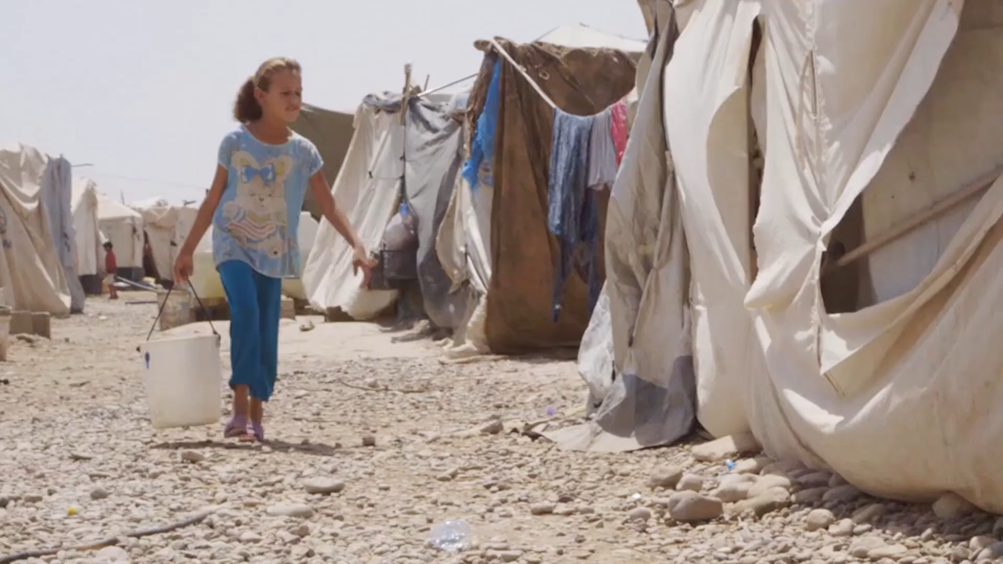
Notes:
Why do you think Alicia is carrying a backpack, rather than on a shelf or in a cupboard?
BC some children have to leave their the world right, now, but we’re going to watch a video about just one example of a girl, about your age, who has had to flee her home because of war.
When a war occurs, all of the really important rights we have just discussed are put at risk.
This is the reality of millions of children around the world.
Saja case study video – 5 mins.
What’s going on in the video? How does that make you feel?
What are the things Saja doesn’t have?
What are the things Save the Children are providing? Can you spot any things from the bag, and what they represent e.g. right to play, have friends, education.
And this is a bigger issue; all over the world children are at risk and have had to leave the safety of their homes because of war.
Extra info:
Saja is 11 years-old. Armed conflict in Iraq meant that Saja and her family were forced to leave their homes.
The journey was very difficult for the family. Some members of her family died along the way.
Saja is now in a safe camp in Khanaqeen, Iraq. She attends a Save the Children Child Friendly Space, where she and her new friends receive the ongoing support that they need.

Slide 12
So what can we do to help?
Notes:
Ask children - so what do you think we can do to help children like Saja / about this? Answers

Slide 13
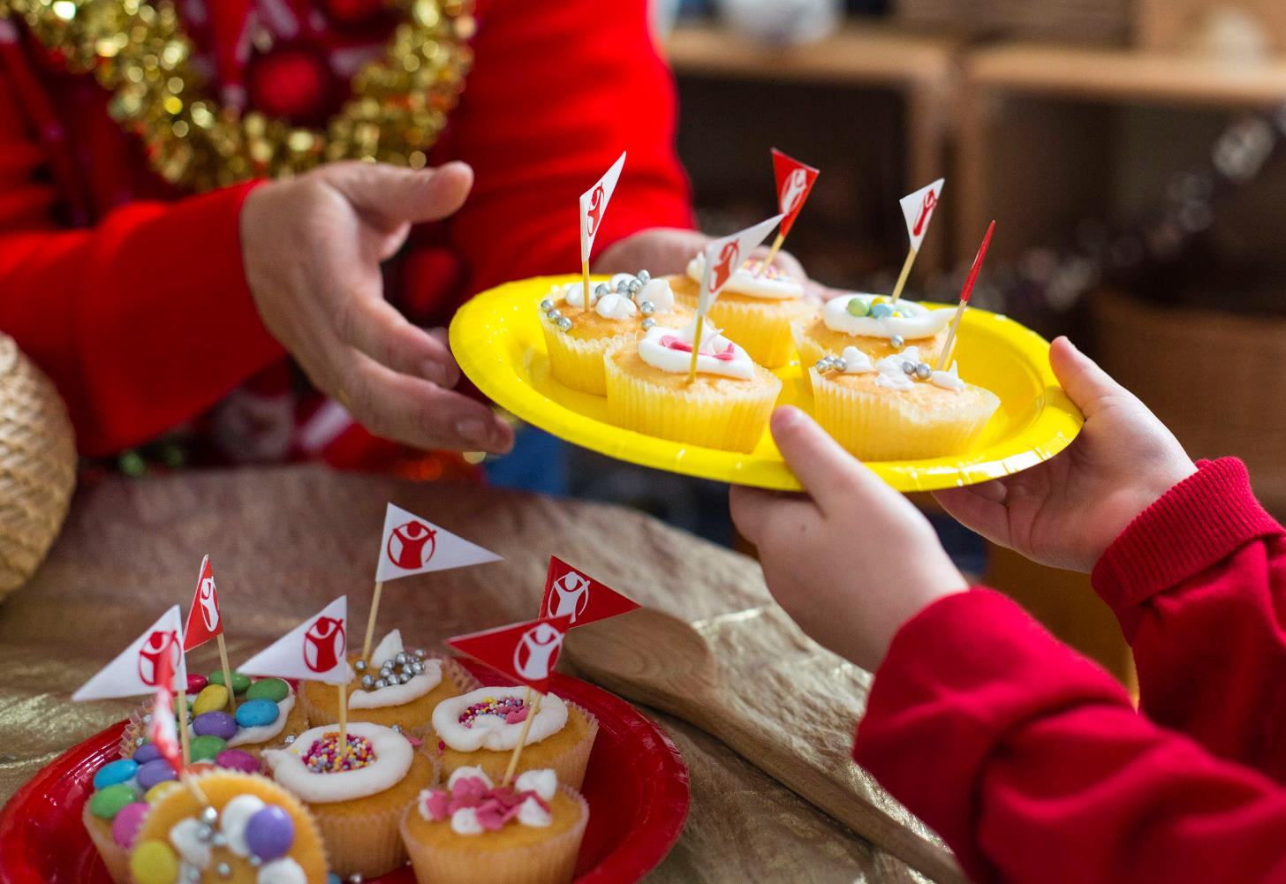
FUNDRAISING
Notes:
We have to pay for things in the bag. That money comes from STC.
When you have events in school like non uniform days and cake sales, this is where the money you raise goes…
Who here has been involved in a fundraiser ?
For example
Your - £1 that you bring in on a non-uniform day - could buy a raincoat to help protect a child refugee from the elements
Your class - £30 - could buy shelter kits for four families in an emergency, including sleeping materials, a torch and batteries.
Your school - £290 - could cover the cost of a Teacher's Kit which contains all the equipment necessary for a teacher with a class of up to 100 children

Slide 14
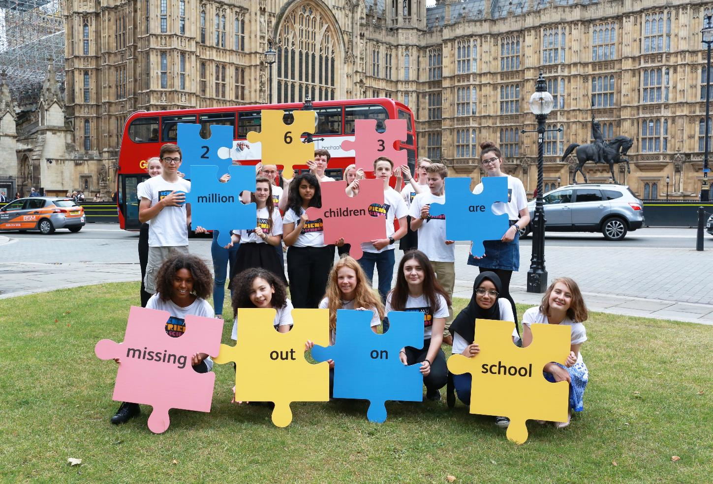
CAMPAIGNING
Notes:
Does anyone know what this word means?
Campaigning – But there’s also another way that you can help people; that’s by using your voice and speaking out for what you believe is right.
There’s lots of ways that you can do that.
Who knows who the prime minister is? Theresa May!
So Theresa May has the power to help protect children in need, like Saja. She can help make sure children like Saja have all the things they need – all the things in the bag.
it’s quite hard to contact Theresa May directly. However every community across the UK, has an MP. Your MP represents the things you care about in government.
You guys are really powerful, and you’ve just told us about why you care about children like Saja.
We are campaigners, and it’s our job to help create change for children like Saja. But we can’t do it without you – so we’re asking you to help us.
If you talk or write to your MP about why you think it’s important to help children like Saja and ask them to help protect them, they can take your messages to Theresa May who can help children in need around the world.
In your topic this term you will be thinking about this word Campaigning, or speaking out about what you care about to help children in need around the world….

Slide 15

Reflection
What have you learned today?
What did you enjoy about it?
What do you want to change in the world?
Notes:
Plenary - 2-5 minutes depending on time
Children fill in their ‘Charlie Brown’, write on paper by answering the questions on the board.
They could then either share with each other in pairs or small groups, or the teacher could ask for example answers from the class.
At end of lesson:
What could you do with your Charlie Browns?
Create bunting to hang up around the classroom, corridor, or around the school. Thus, children using the classroom in future can see what they’ve learned, and how other children in their school have learned with StC how to change the world.
OR send them to your MP, asking the question “Why do you think it’s important to protect children in war?”.

Slide 16
Want to do more to help children in need?
Learn more about peace, conflict and how you can create change with our resources.
Campaign in your school and community!
Fundraising
Notes:
See our schools resources here: https://www.savethechildren.org.uk/how-you-can-help/show-your-support/childrens-campaigning

Slide 18

Notes:
Charlie Brown template – print in colour for children to do their reflection piece.

